Slide 1

Starting Javascript
BY : Anjali Sharma

Slide 2
Introduction
Used by web browsers to create dynamic and interactive
experience for users .
Variables : -
(containers for storing value)
Local Variable ( let, const ) :- define and used in block
Global Variable (var) : - define outside block & used anywhere
 | var | let | const
initialization | Not mandatory | Not mandatory | Mandatory
Reassign variable | Yes | No | No
redeclared | Yes | Yes | No

Slide 3
Variable Declaration
Var example :- var a;
var a=10;
var a=20;
Name Convention :
Case sensitive names
Can include digit , letter, _$
Letter,_,$ can be first character
No keyword allowed
let example :- let a;
a=10;
a=20;
const example :- const a=10;
a=20; {ERROR}

Slide 4
JS values
In JS we don’t use datatype indicator (int, float etc.) . But variable can have different type of value
These are divide into two types :
reference types :- mutable data which store as reference in memory like array , object , function .
primitive types :- immutable data which directly store in memory like
Number (10) ,
string (“ram”),
boolean (true),
undefined (let y),
null (let y=null )

Slide 5
Document Object Model (DOM)
structured representation of the HTML document created by the browser.
It allows JavaScript to manipulate, structure, and style your website.
document
Head
Body
H1
Web technologies
Button
Change heading
html
<!DOCTYPE html>
<html>
<head></head>
<body>
<h1>Web Technologies</h1>
<button>Change Heading</button>
</body>
</html>
Html document
HTML DOM Tree

Slide 6
Document Object : It is the entry point of the DOM. For accessing any HTML Element, you should always start with accessing the document object first.
HTML DOM Tree : The DOM tree represents an HTML document as nodes. Each node is referred to as an object.
HTML document : html code which design basic structure of website

Slide 7
JS Selectors
To maintaining elements of DOM first we need to select them for this we have selectors
document.getElementById() :- It select by id of element
document.getElementsByClassName():- it select by class name
document.getElementsByTagName() :- It select elements by tag name
CSS selectors :-
Document.querySelector(selector) : return first matching element for selector
Document.querySelectorAll(selector) : return all elements of selectors

Slide 8
DOM properties
innerText :- return or set visible text content and its children
innerHTML :- return or set entire HTML inside an element
textContent :- return or set entire textContent of element no matter if hidden or not
tagName :- return tag name of an element
value :- get or set the value of input element
Style :- modify css of element, uses property name in camelCase (text.style.fontSize=25px)

Slide 9
Event Handlers
Event are actions that trigger changes in document and enable user to interact with elements
Many kind of event handlers :-
onclick, ondbclick, onmouseover, oninput, onsubmit, onchange, onfocus
Event Listeners :-
Three type of event listener
Using as html attribute :-
onclick= “jsfuntion()”
Using node :-
btn.onClick = function(){ //code }
Using listeners :-
addEventListener( “click” ,function() { //code } )

Slide 10
Lets do a practice
build a mini feedback board with ( Loved it , Average, Bad ) buttons and when a user clicks on buttons
A thank-you message appears.
The clicked button should show
They can click again to change their response.

Slide 11

Thank You
ALL THE BEST !!!

Slide 12
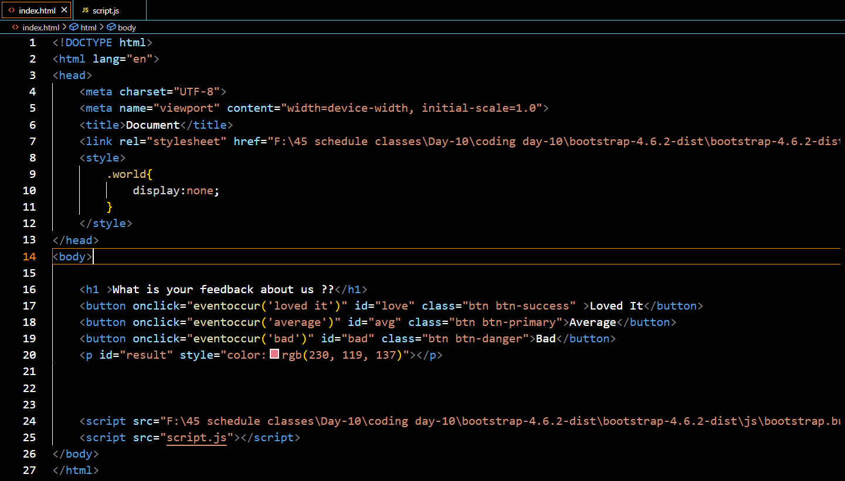
Class practice code

Slide 13
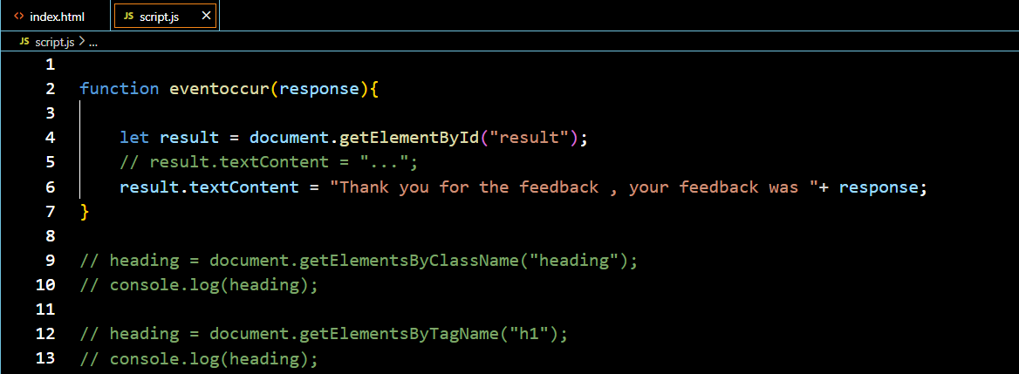
NOTE :- I’m not uploading this code on GitHub because it's a practice session. Instead, I’m sharing an image of the code here. I want each of you to try writing it at least once on your own — it will help you understand the flow

